Slide 1
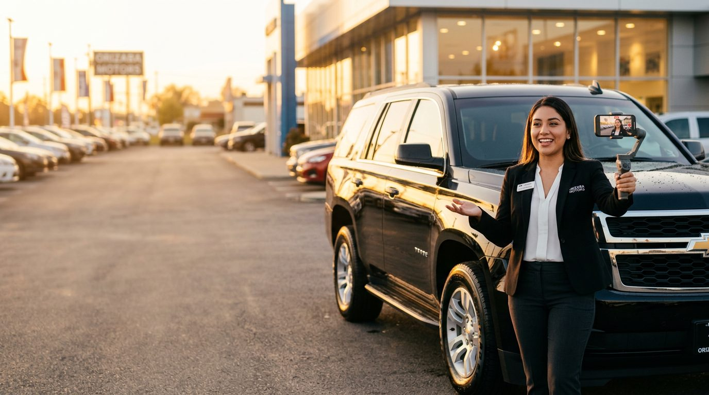
CAR-SPACE
DEALER PLAYBOOK
Turn your sales floor into a lead engine.
How dealerships use short-form salesperson video to generate first-party leads — and rely less on rented ones.
acarspace.com

Slide 2
THE PROBLEM
Most stores rent their demand.
01
02
03
Paying per lead
Listings all look the same
Green peas starve
Third-party marketplaces invoice every lead — and the same shopper is often sold to the store down the street.
Static photos and spec sheets don’t show personality, sound, space or the person who will sell the car.
New hires quit when the phone doesn’t ring. Turnover costs you training time and deals.
CAR-SPACE · Dealer Playbook
02

Slide 3
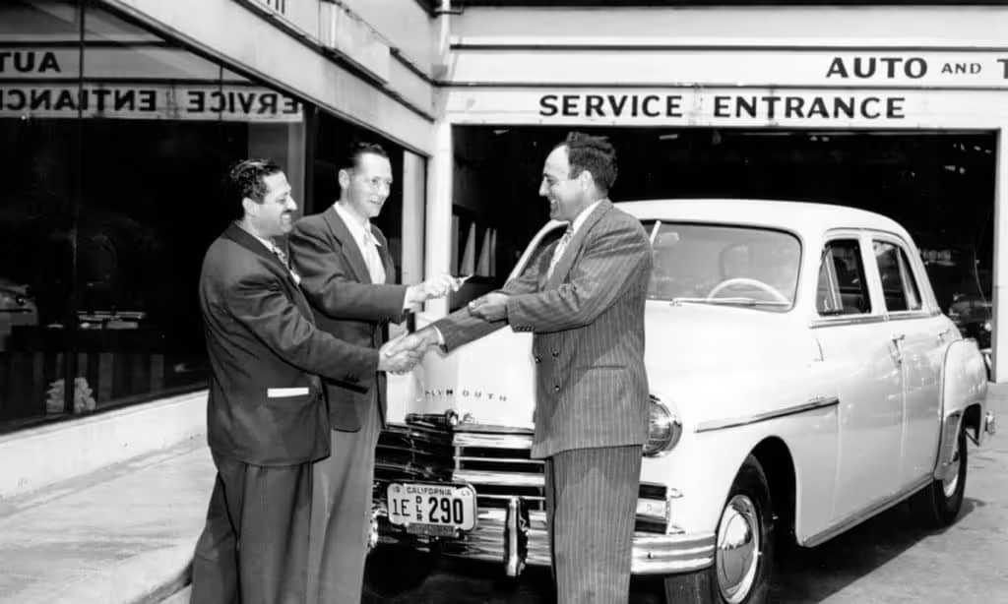
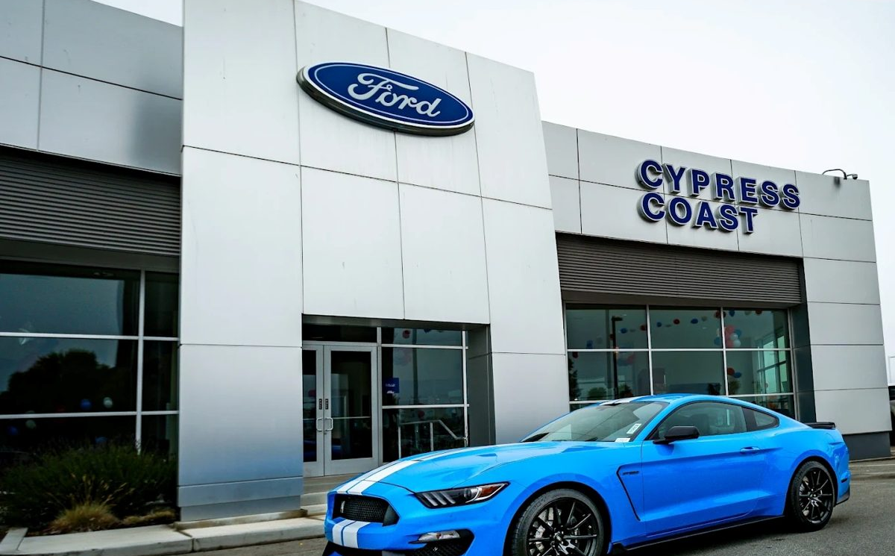

THE SHIFT
Buyers still buy from people. They just meet them on a screen now.
1950S
TODAY
NEXT
The handshake era
The listing era
The creator era
The salesperson was the showroom, the brochure and the reason you came back.
Shoppers research online first. Your people are hidden behind stock photos.
Shoppers follow salespeople they trust — and walk in already sold.
CAR-SPACE · Dealer Playbook
03

Slide 4
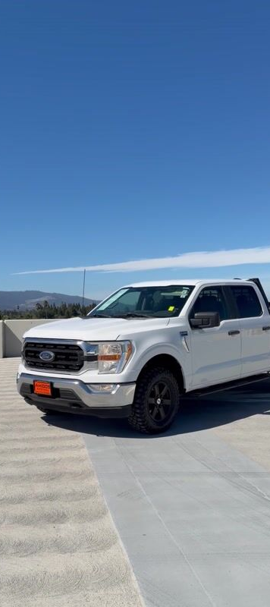

WHAT CAR-SPACE IS
TikTok for car sales — built for your inventory.
Salespeople post 30–90 second walkaround videos from their phone.
Each video is tagged to a real unit — price, miles and trim attach automatically.
Shoppers scroll, save cars to their Garage and follow agents they trust.
One tap on “I’m interested” sends the lead straight to the agent who made the video.
CAR-SPACE · Dealer Playbook
04

Slide 5
HOW IT WORKS
Six steps from phone to paperwork.
01
02
03
Record
Tag
Post
Shoot a 30–90 second vertical walkaround. No editing required.
Link it to the unit in your inventory — details attach automatically.
It hits the feed, the agent’s profile and a one-tap share link.
04
05
06
Grow
Capture
Close
Shoppers like, comment, save and follow the agents they trust.
“I’m interested” routes a warm lead to the agent, vehicle attached.
The buyer arrives already knowing the car — and the salesperson.
CAR-SPACE · Dealer Playbook
05

Slide 6
WHAT YOUR STORE GETS
Less lead dependency. More control.
01
02
03
Lower cost per sale
Every unit gets a video
Recruit & retain closers
Organic video leads don’t carry a per-lead invoice.
Narrated walkarounds without a production budget.
Give top talent a platform to grow on.
04
05
06
See who drives demand
Win underserved markets
Verified, on-brand content
Views, saves, follows and lead taps by agent and vehicle.
Bilingual agents reach buyers in their own language.
Posts come from verified salespeople tied to real inventory.
CAR-SPACE · Dealer Playbook
06

Slide 7
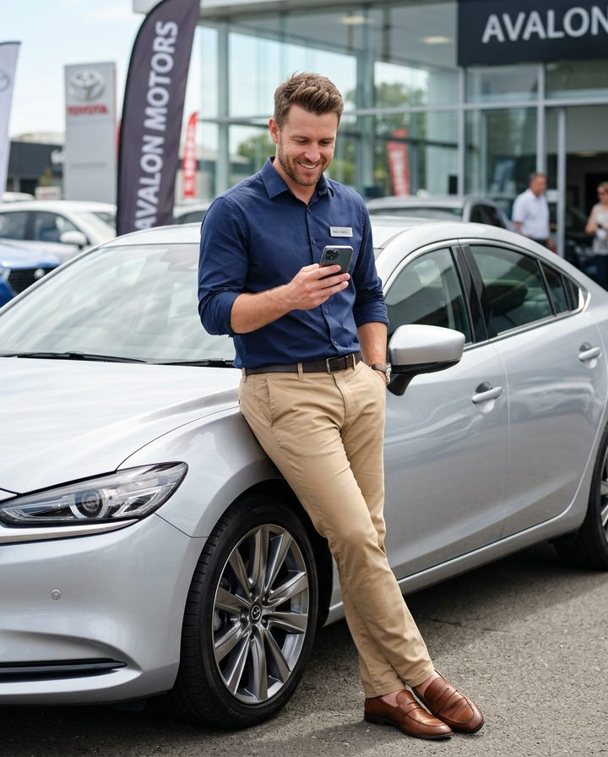
THE TURNOVER ANSWER
Agents who own an audience don’t starve — and don’t leave.
New hires build a pipeline from day one. Your best creators stay where they’re supported.
Faster ramp for green peas
Veterans monetize their reputation
A recruiting pitch competitors can’t match
CAR-SPACE · Dealer Playbook
07

Slide 8
ROLLOUT
Live on your lot in 30 days.
1
2
3
4
WEEK 1
WEEK 2
WEEKS 3–4
DAY 30
Set up your store
Creator bootcamp
Daily posting cadence
Review the numbers
Create the dealership account, connect inventory and invite your sales team. Admins control who posts.
A short on-lot session: framing, hooks, 60-second walkaround scripts and bilingual posting.
Each agent posts a few walkarounds a day. Leaderboards keep it competitive.
Compare organic leads, appointments and cost per sale to your vendor leads. Scale what works.
CAR-SPACE · Dealer Playbook
08

Slide 9
RUNNING IT
The sales manager’s daily rhythm.
Morning huddle
Shoot between ups
Pick the units to feature today: fresh trade-ins, aged inventory, hot sellers. Assign one or two per agent.
Agents film 2–3 walkarounds each during downtime. Phone, vertical, 30–90 seconds.
Boost the hot units
Work the leads fast
Push a video to the top of its body style or brand for $10 — or both for $15.
“I’m interested” leads go to the agent. Set a response-time standard and hold to it.
TRACK WEEKLY
Videos per agent
Views & follows
“I’m interested” taps
Appointments set
Cost per sale vs. vendor leads
CAR-SPACE · Dealer Playbook
09

Slide 10
CAR-SPACE LAUNCH SPECIAL
$399/mo
INCLUDED
Full dealership platform
Maintenance included
Room for up to 15 agents
$0 setup fee · Limited time
Go live immediately
The full platform, maintenance included, with room for 15 of your agents (agents subscribe at $25/mo each). Lock in launch pricing while it lasts.
Inventory-linked videos
No per-lead fees — ever
CAR-SPACE · Dealer Playbook
10

Slide 11

NEXT STEP
Put your sales team on camera.
Book a dealer demo and we’ll map your 30-day rollout.
acarspace.com/get-started
CAR-SPACE · Dealer Playbook
11

